Slide 2
416
(2%)
472
(2%)
459
(2%)
7977
(31%)
8310
(31%)
9107
(34%)
308
(2%)
5037
(32%)
199
(2%)
17175
(67%)
17752
(67%)
17140
(64%)
109
(2%)
10591
(66%)
3466
(33%)
6855
(65%)
1571
(29%)
44
(2%)
电销
48
(2%)
50
(2%)
1093
(39%)
46
(2%)
渠道
3736
(69%)
666
(30%)
862
(35%)
1697
(60%)
644
(29%)
1507
(68%)
1558
(63%)
1518
(69%)
直营
FY26Q2
FY26Q3
FY26Q4
FY27Q1td
4月
5月mtd
W4
W3
W2
W1

Slide 3
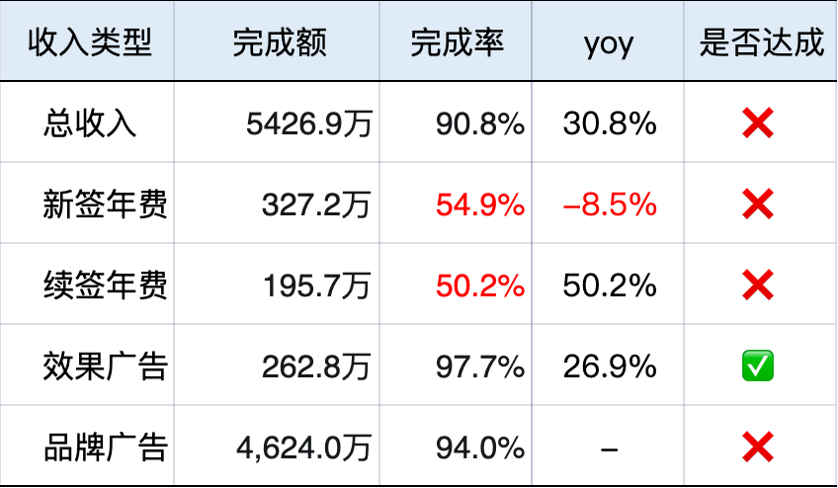
完成趋势by收入结构（Q&M&W) 截止0517 | YOY达成情况
低频收入结构
分收入结构yoy
YOY达成情况
25552
26499
26683
12090
2831
103.2%
107.9%
9.0%
11.2%
13.7%
14.1%
10515
2468
2205
2185
73.0%
5.3%
5.3%
5.9%
6.4%
13.3%
15.6%
20.7%
64.2%
15925
5.7%
7.8%
5.6%
6.3%
7.2%
52.6%
50.2%
10.8%
5188
3.2%
5.5%
41.5%
49.5%
5.0%
8.4%
5427
37.1%
36.2%
36.7%
30.9%
82.4%
78.7%
74.7%
73.5%
74.9%
6.0%
63.5%
24.6%
26.9%
78.5%
5.8%
3.6%
73.3%
87.5%
84.3%
15.1%
80.7%
85.5%
-8.5%
3.3%
4.8%
5.7%
5.6%
5.0%
6.0%
6.0%
4.9%
3.3%
10.2%
3.0%
3.0%
FY26Q2
FY26Q3
FY26Q4
FY27Q1
2月
3月
4月
5月mtd
FY26Q2
FY26Q3
FY26Q4
FY27Q1
2月
3月
4月
5月
m4w3
m4w4
m5w1
m5w2
季度变化趋势
月度变化趋势
月度变化趋势
季度变化趋势
月度变化趋势
新签年费
续签年费
效果广告
品牌广告
总收入
新签年费
续签年费
效果广告
Notes:
低频收入结构

Slide 4
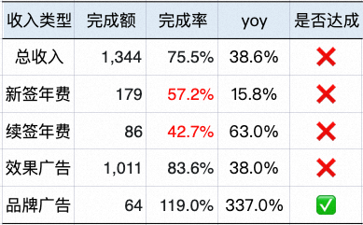
【教培】完成趋势by收入结构（Q&M&W) 截止0517 | YOY达成情况
低频收入结构
分收入结构yoy
YOY达成情况
7043
7419
3660
691
103.2%
107.9%
6188
660
556
600
17.7%
24.6%
25.2%
2812
20.1%
15.4%
73.0%
64.2%
10.0%
23.0%
8.8%
4316
7.9%
20.1%
15.8%
28.4%
13.6%
9.2%
52.6%
50.2%
9.4%
17.7%
11.0%
11.5%
5.2%
41.5%
49.5%
11.0%
1299
1344
37.1%
36.2%
36.7%
26.9%
30.9%
68.1%
62.2%
61.5%
19.9%
63.4%
66.2%
13.4%
62.3%
55.3%
76.8%
72.5%
24.6%
15.1%
68.0%
9.9%
6.4%
-8.5%
64.2%
75.5%
4.1%
5.4%
5.2%
3.3%
2月
6.0%
3.5%
2.6%
4.7%
1.8%
4.8%
4.4%
2.9%
FY26Q2
FY26Q3
FY26Q4
FY27Q1
2月
3月
4月
5月mtd
FY26Q2
FY26Q3
FY26Q4
FY27Q1
3月
4月
5月
m4w3
m4w4
m5w1
m5w2
季度变化趋势
月度变化趋势
月度变化趋势
季度变化趋势
月度变化趋势
新签年费
续签年费
效果广告
品牌广告收入
总收入
新签年费
续签年费
效果广告
Notes:
低频收入结构

Slide 5
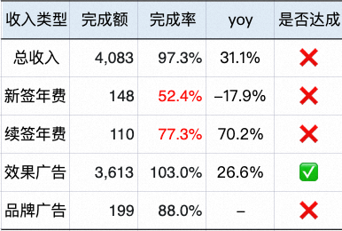
【医疗】完成趋势by收入结构（Q&M&W) 截止0517 | YOY达成情况
低频收入结构
分收入结构yoy
YOY达成情况
25552
26499
26683
8429
2831
155.0%
11.2%
13.7%
9.3%
7702
2468
9.0%
5.3%
5.7%
10.8%
20.7%
2205
2185
127.0%
5.3%
5.9%
3.8%
15.6%
5.6%
6.3%
7.2%
10.8%
15925
7.8%
3.2%
5.5%
65.4%
70.0%
5.0%
3889
4083
4.6%
77.9%
78.1%
3.6%
38.0%
47.0%
45.0%
82.4%
78.7%
74.7%
4.5%
2.7%
73.3%
63.5%
35.0%
35.0%
31.0%
87.5%
84.3%
34.0%
78.5%
86.2%
88.8%
31.0%
28.0%
27.0%
7.1%
7.3%
10.2%
5.0%
-18.0%
3.3%
4.8%
5.7%
5.6%
2月
4.7%
3月
4月
4.9%
5月
3.3%
3.0%
3.0%
FY26Q2
FY26Q3
FY26Q4
FY27Q1
m4w3
m4w4
m5w1
m5w2
FY26Q2
FY26Q3
FY26Q4
FY27Q1
2月
3月
4月
5月mtd
季度变化趋势
月度变化趋势
月度变化趋势
季度变化趋势
月度变化趋势
新签年费
续签年费
效果广告
品牌广告
总收入
新签年费
续签年费
效果广告
Notes:
低频收入结构

Slide 6
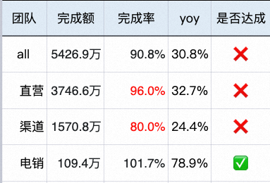
完成趋势by渠道（Q&M&W) 截止0517 | YOY达成情况
低频分渠道收入趋势&占比
分渠道收入yoy
YOY达成情况
26534
26706
12100
2834
77.8%
81.5%
74.0%
76.5%
77.0%
74.6%
78.9%
25568
1.8%
1.7%
1.8%
10520
2470
1.5%
74.9%
1.6%
31.3%
34.1%
1.9%
2.0%
2208
2187
52.0%
66.3%
31.2%
15936
33.7%
34.9%
38.6%
2.1%
2.2%
47.4%
41.4%
50.8%
1.9%
32.9%
29.2%
30.7%
42.9%
42.6%
32.7%
31.6%
5192
5416
36.5%
38.7%
39.1%
1.7%
2.0%
67.2%
66.9%
64.2%
32.0%
64.5%
65.2%
29.0%
63.1%
59.9%
68.8%
67.1%
24.4%
66.5%
66.3%
69.0%
FY26Q2
FY26Q3
FY26Q4
FY27Q1td
2月
3月
4月
5月td
m4w3
m4w4
m5w1
m5w2
FY26Q2
FY26Q3
FY26Q4
FY27Q1
2月
3月
4月
5月mtd
季度变化趋势
月度变化趋势
月度变化趋势
季度变化趋势
月度变化趋势
电销
渠道
直营
电销
渠道
直营
Notes:
低频收入结构

Slide 7
25568
26534
26706
12100
2834
1.6%
1.8%
1.7%
1.8%
10520
2470
1.5%
31.2%
31.3%
34.1%
1.9%
2.0%
2208
2187
15936
33.7%
32.9%
34.9%
38.6%
2.1%
2.2%
1.9%
29.2%
30.7%
31.6%
5192
5416
67.2%
66.9%
64.2%
1.7%
2.0%
66.5%
32.0%
64.5%
65.2%
29.0%
63.1%
59.9%
68.8%
67.1%
66.3%
69.0%
FY26Q2
FY26Q3
FY26Q4
FY27Q1td
总收入by团队
2月
3月
4月
5月td
m4w3
m4w4
m5w1
m5w2
电销
渠道
直营
分团队yoy
77.8%
81.5%
74.0%
76.5%
77.0%
74.6%
78.9%
66.3%
74.9%
52.0%
47.4%
49.5%
52.7%
50.8%
41.4%
46.0%
41.5%
42.9%
40.3%
42.6%
32.7%
36.5%
38.7%
39.1%
30.8%
24.4%
FY26Q2
FY26Q3
FY26Q4
FY27Q1
-8.4%
2月
3月
4月
5月mtd
电销
直营
渠道
all
Notes:
总收入：直营｜渠道｜电销

Slide 8
20321
19276
8434
7706
2172
18522
0.4%
0.3%
0.3%
0.4%
1778
0.2%
0.3%
27.6%
28.3%
0.5%
1650
1586
26.9%
29.5%
30.4%
33.8%
36.1%
0.6%
0.4%
11779
3892
4073
24.9%
27.2%
0.4%
0.3%
0.4%
72.8%
72.1%
70.1%
28.6%
27.9%
71.3%
69.2%
25.3%
71.0%
71.8%
74.3%
65.7%
63.7%
74.5%
72.4%
医疗
FY26Q2
FY26Q3
FY26Q4
FY27Q1td
2月
3月
4月
5月mtd
W4
W3
W2
W1
电销
渠道
直营
医疗
290.0%
230.0%
190.0%
200.0%
169.0%
132.0%
78.6%
76.6%
100.0%
47.9%
46.7%
52.6%
66.9%
67.2%
35.0%
37.4%
47.3%
36.5%
40.9%
45.2%
37.8%
39.3%
47.1%
32.2%
31.1%
30.7%
-2.4%
27.2%
FY26Q2
FY26Q3
FY26Q4
FY27Q1
-6.3%
2月
3月
4月
5月mtd
电销
渠道
直营
all
Notes:
医疗总收入：直营｜渠道｜电销；

Slide 9
7045
7433
3666
692
5.9%
662
601
5.2%
6212
5.3%
5.3%
2814
5.9%
557
7.0%
42.6%
6.3%
46.0%
46.0%
6.0%
37.8%
6.5%
39.9%
43.6%
4157
39.9%
46.7%
41.6%
6.3%
1302
1343
40.0%
6.0%
6.8%
56.3%
52.3%
50.1%
48.7%
44.2%
48.7%
54.1%
40.3%
47.4%
51.9%
53.1%
53.7%
49.8%
52.9%
教培
FY26Q2
FY26Q3
FY26Q4
FY27Q1td
2月
3月
4月
5月mtd
W4
W3
W2
W1
电销
渠道
直营
教培
87.4%
76.3%
69.8%
65.9%
72.9%
71.0%
63.3%
62.3%
63.8%
55.4%
67.2%
62.5%
59.5%
48.8%
54.3%
49.7%
61.7%
57.7%
44.1%
38.6%
43.1%
35.0%
23.1%
24.9%
30.0%
19.4%
-9.3%
FY26Q2
FY26Q3
FY26Q4
FY27Q1
-27.3%
2月
3月
4月
5月mtd
电销
直营
渠道
all
Notes:
教培总收入：直营｜渠道｜电销

Slide 10
20311
19265
8429
7702
2171
18513
7.7%
9.6%
9.3%
10.8%
5.6%
4.1%
4.7%
5.7%
3.8%
1777
18.3%
1650
1585
3.6%
12026
13.9%
3.9%
3.9%
4.1%
8.2%
3889
4324
4.6%
2.5%
4.1%
3.4%
4.6%
77.9%
78.1%
3.7%
87.8%
83.7%
79.9%
4.5%
2.7%
77.5%
66.0%
91.2%
88.8%
81.8%
86.2%
88.4%
3.0%
4.6%
5.9%
6.5%
4.7%
7.1%
7.3%
5.2%
医疗
3.9%
11.8%
2.5%
3.0%
FY26Q2
FY26Q3
FY26Q4
FY27Q1td
2月
3月
4月
5月mtd
W4
W3
W2
W1
新签年费
续签年费
广告现金收入
品牌广告收入
医疗分结构yoy
154.8%
126.5%
136.3%
84.3%
70.2%
59.8%
65.4%
51.7%
63.1%
35.0%
39.4%
43.9%
47.3%
40.9%
47.1%
31.1%
33.8%
34.6%
45.2%
31.0%
29.2%
5.1%
27.7%
-2.4%
28.3%
28.4%
26.6%
-38.9%
-19.7%
-17.9%
FY26Q2
FY26Q3
FY26Q4
FY27Q1
2月
3月
4月
5月mtd
总收入
新签年费
续签年费
广告现金收入
Notes:
医疗*收入类型

Slide 11
7043
7419
3660
691
660
17.7%
6188
24.6%
25.2%
2812
20.1%
556
600
23.0%
7.9%
20.1%
15.8%
28.4%
13.6%
15.4%
10.0%
8.8%
4316
5.2%
9.2%
9.4%
17.7%
1299
11.0%
1504
11.5%
68.1%
61.4%
11.0%
19.9%
63.4%
66.2%
13.3%
62.3%
76.8%
72.5%
62.2%
68.0%
9.9%
10.9%
55.3%
64.2%
71.3%
教培
4.1%
5.4%
5.2%
3.3%
2月
6.0%
3.5%
2.6%
4.5%
1.8%
4.8%
4.4%
2.9%
FY26Q2
FY26Q3
FY26Q4
FY27Q1td
3月
4月
5月mtd
W4
W3
W2
W1
新签年费
续签年费
广告现金收入
品牌广告收入
教培分结构yoy
94.3%
62.6%
69.0%
63.0%
72.9%
75.1%
62.3%
54.3%
48.1%
55.4%
67.6%
43.1%
40.8%
42.1%
38.6%
44.2%
30.5%
31.7%
32.5%
38.0%
30.0%
18.1%
15.8%
11.2%
21.5%
27.9%
-17.9%
1.1%
-22.7%
-28.1%
FY26Q2
FY26Q3
FY26Q4
FY27Q1
2月
3月
4月
5月mtd
总收入
新签年费
续签年费
广告现金收入
Notes:
教培*收入类型

Slide 12
20321
19276
8434
7706
2172
18522
0.4%
0.3%
0.3%
0.4%
1778
0.2%
0.3%
27.6%
28.3%
0.5%
1650
1586
26.9%
29.5%
30.4%
33.8%
36.1%
0.6%
0.4%
11779
3892
4073
24.9%
27.2%
0.4%
0.3%
0.4%
72.8%
72.1%
70.1%
28.6%
27.9%
71.3%
69.2%
25.3%
71.0%
71.8%
74.3%
65.7%
63.7%
74.5%
72.4%
医疗
FY26Q2
FY26Q3
FY26Q4
FY27Q1td
2月
3月
4月
5月mtd
W4
W3
W2
W1
电销
渠道
直营
分结构yoy
290.0%
230.0%
190.0%
200.0%
169.0%
132.0%
78.6%
76.6%
100.0%
47.9%
46.7%
52.6%
66.9%
67.2%
35.0%
37.4%
47.3%
36.5%
40.9%
45.2%
37.8%
39.3%
47.1%
32.2%
31.1%
30.7%
-2.4%
27.2%
FY26Q2
FY26Q3
FY26Q4
FY27Q1
-6.3%
2月
3月
4月
5月mtd
电销
渠道
直营
all
Notes:
直营by收入类型

